Slide 1
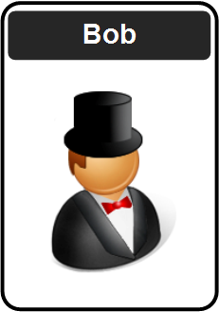



Future of Digital Trust
Prof Bill Buchanan OBE FRSE
https://asecuritysite.com
Zero Knowledge Proofs Fiat Shamir, DLEQ, zkSnarks,
Ring Signatures, Range Proofs, Accumulators, Pedersen Commitments
Homomorphic Encryption:
Basics
Concepts and Code Data Sharing Cloud Processing MPC Machine Learning

Slide 2
Cryptography Overview
Prof Bill Buchanan OBE FRSE
https://asecuritysite.com

Slide 3
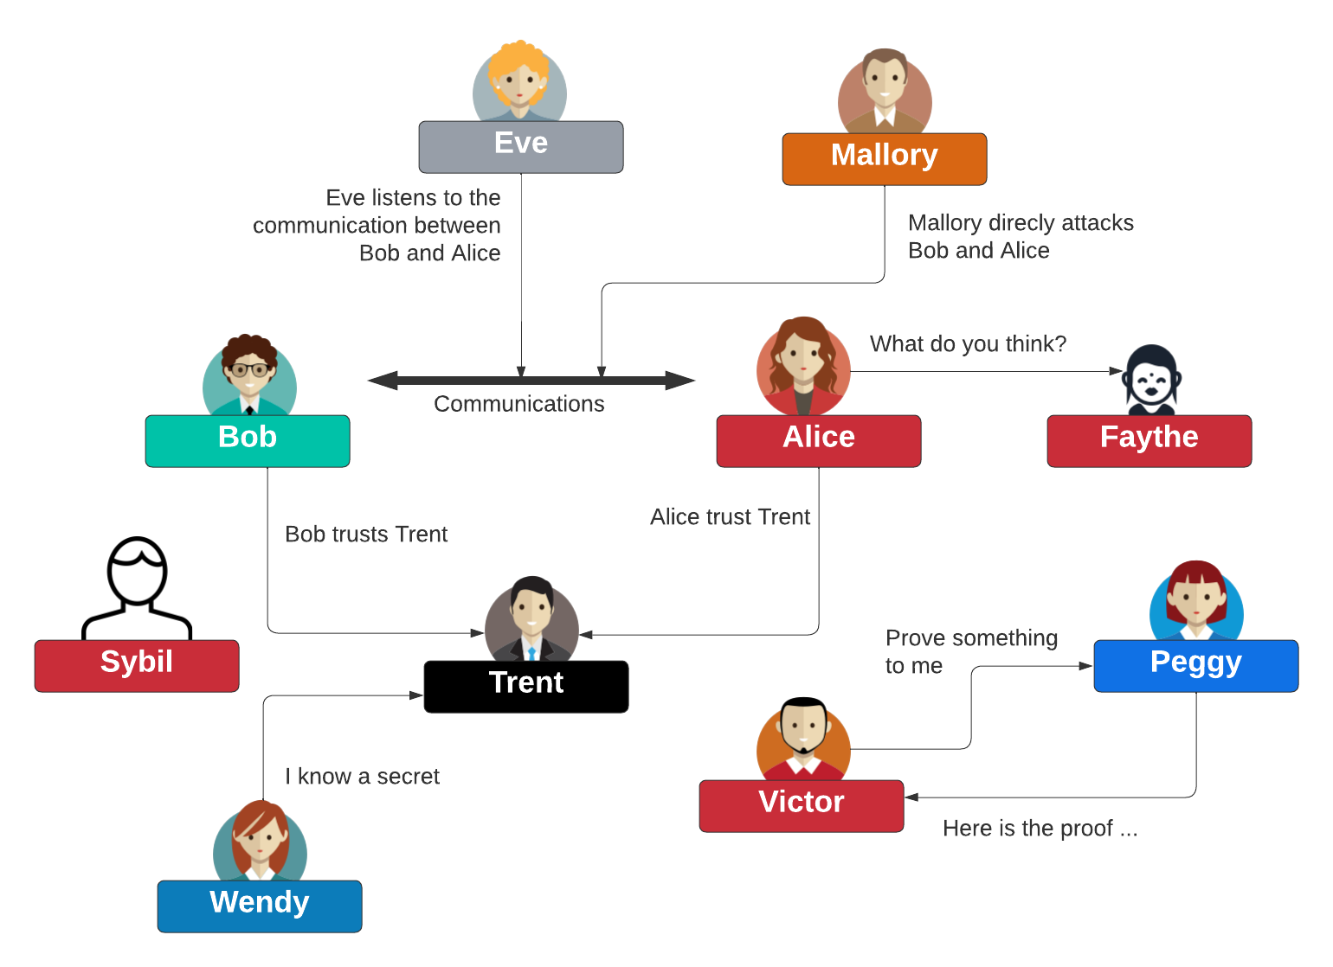
Some Actors

Slide 4
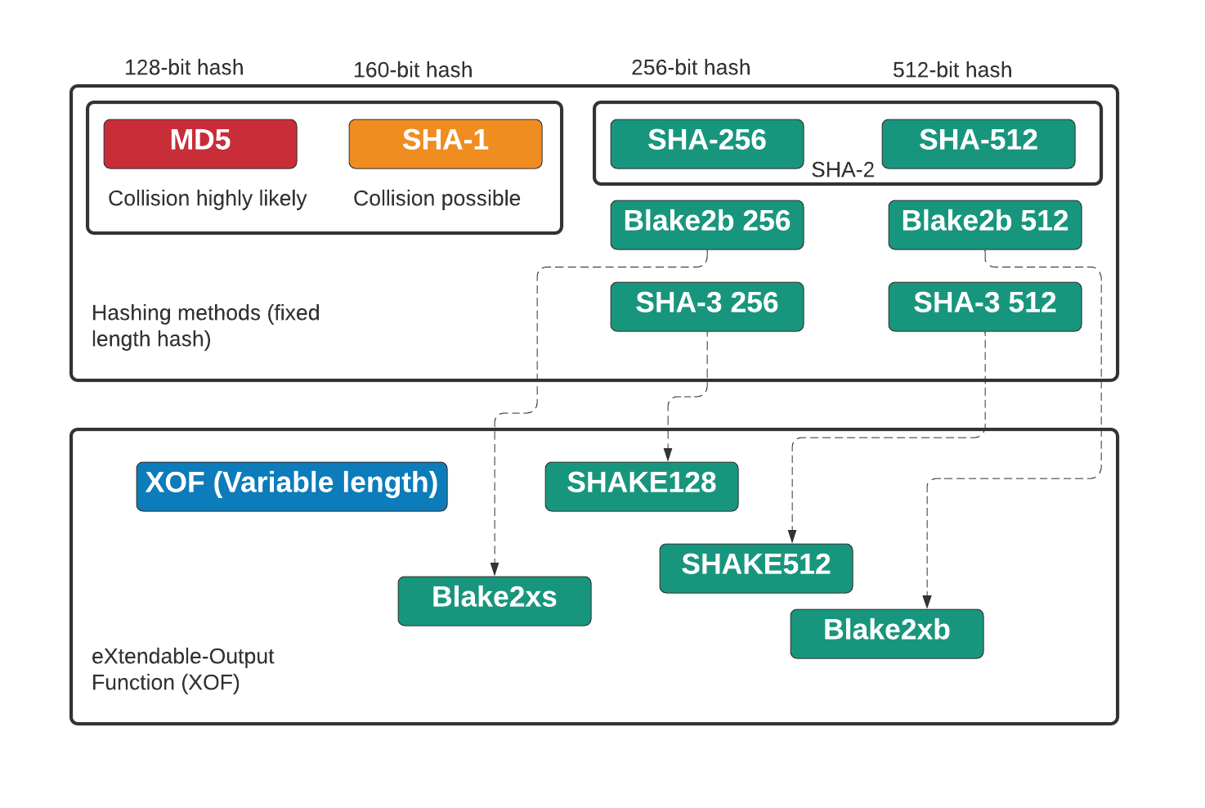
MD5, SHA-1, SHA-2, SHA-3 and XOF
https://asecuritysite.com/hash/cs

Slide 5
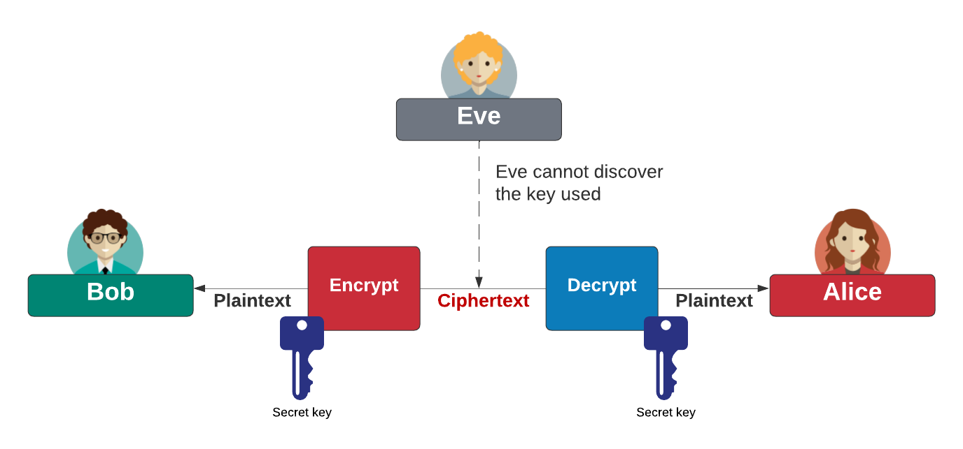
Symmetric Key
Block cipher: AES (128-bit block), DES (64-bit block), 3DES (64-bit block), Blowfish, SM4, Camellia, GOST, IDEA, RC2, Serpent, Skipjack, Twofish, and XTEA Stream cipher: ChaCha20, AES GCM, ARIA, Sala20, and RC4. AES also known as Rijndael (after Joan Daemen and Vincent Rijmen). ChaCha20 created by Daniel J Bernstein. Blowfish and Twofish created by Bruce Schneier.

Slide 6
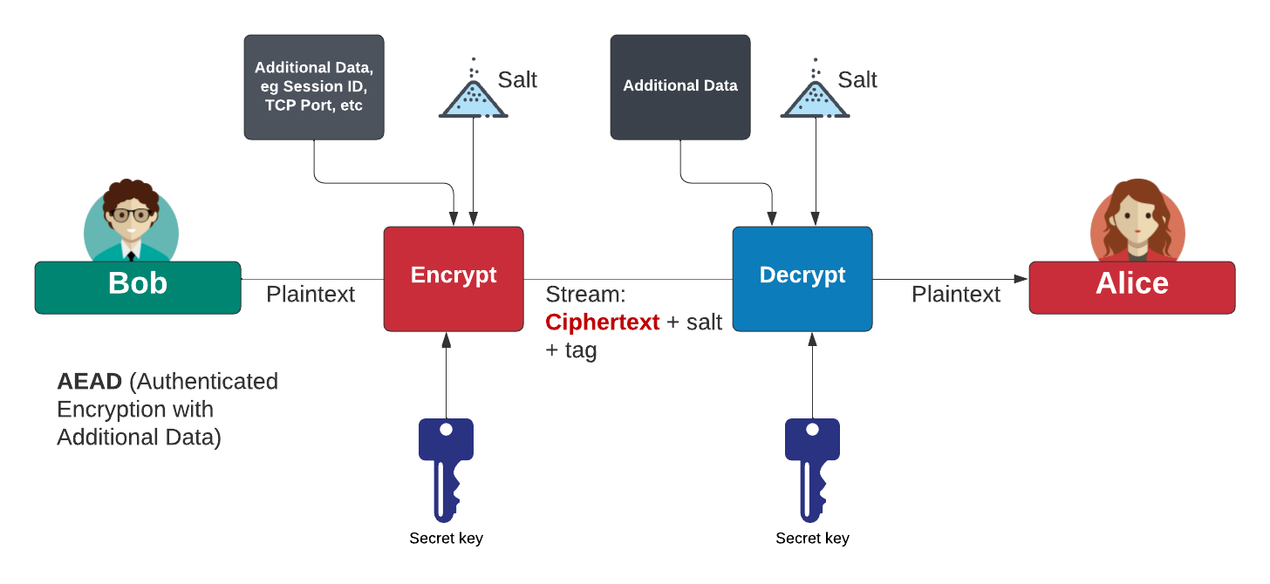
Authenticated Encryption with Additional Data (AEAD)
AES Block cipher modes: ECB (No salt), CBC (Cipher Block Chaining).
AES Stream modes: CFB (Cipher Feedback), OFB (Output Feedback), CTR (Counter), GCM (Galois Counter Mode).
https://asecuritysite.com/golang/go_symmetric

Slide 7
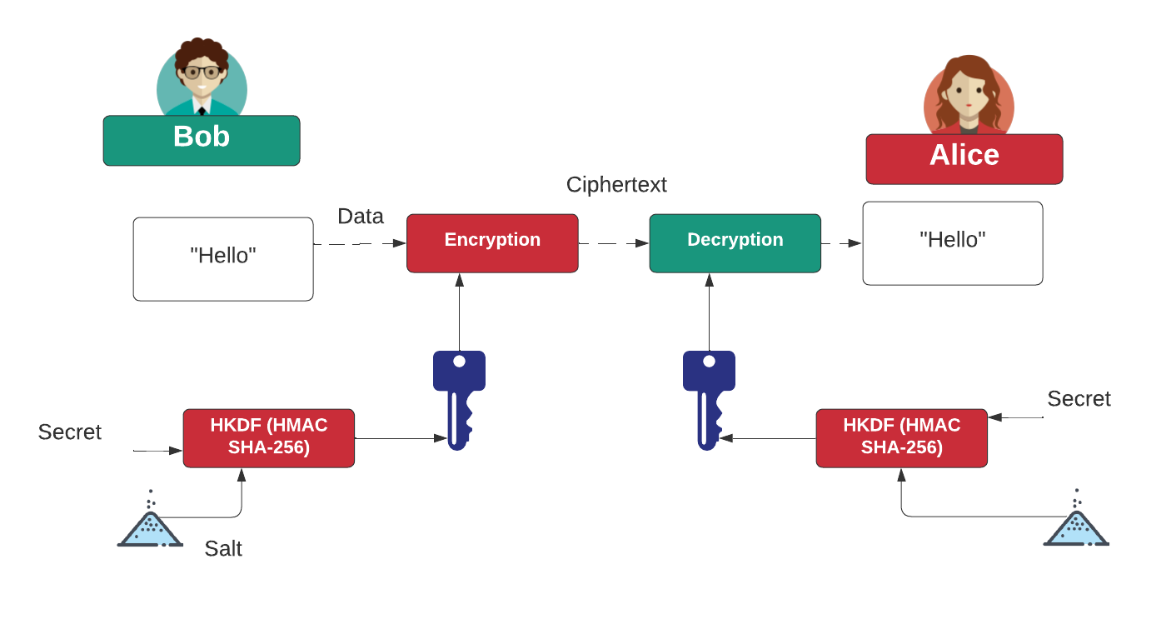
HKDF (HMAC Key Derivation Function)
https://asecuritysite.com/pbkdf2/hashnew3

Slide 8
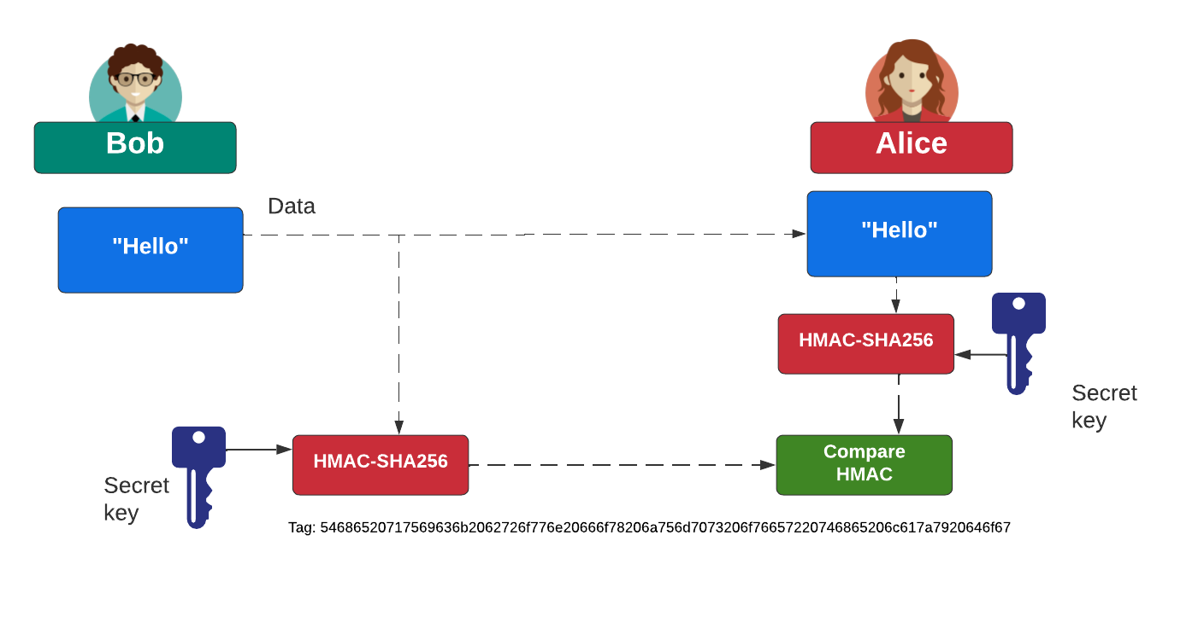
HMAC (Key Hash Message Authentication Code)
https://asecuritysite.com/mac/hashnew2

Slide 9
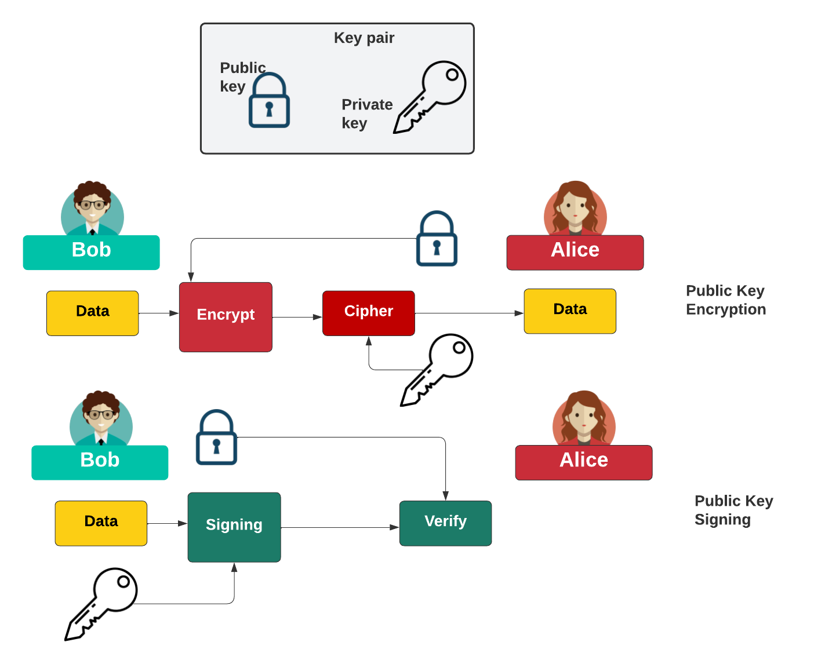
Public Key

Slide 10
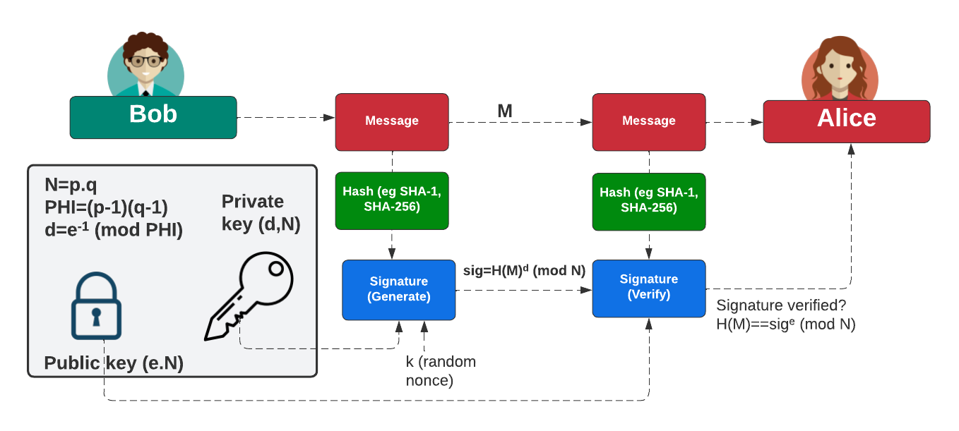
Digital Signatures

Slide 11
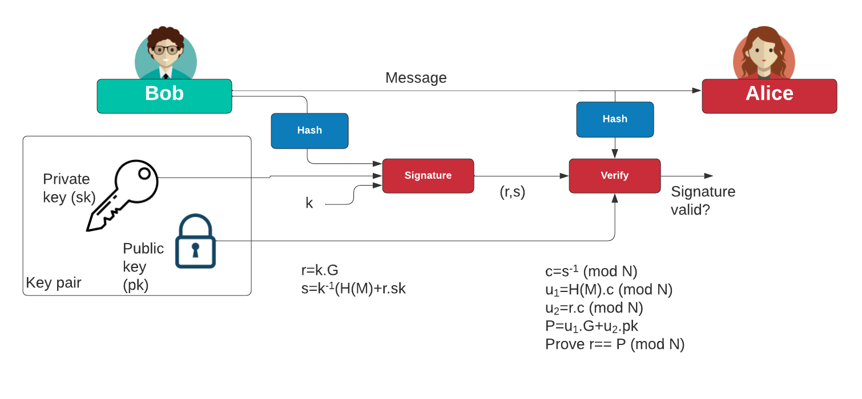
ECDSA
https://asecuritysite.com/ecdsa/ecdsa3

Slide 12
Zero Knowledge Proofs
Prof Bill Buchanan OBE FRSE
https://asecuritysite.com/zero
https://asecuritysite.com/dleq

Slide 13
Zero-knowledge Proof
Peggy is the prover.
Victor is the verifier.
Ali Baba - poor woodcutter - discovers the secret of a thieves as “open sesame”

Slide 14
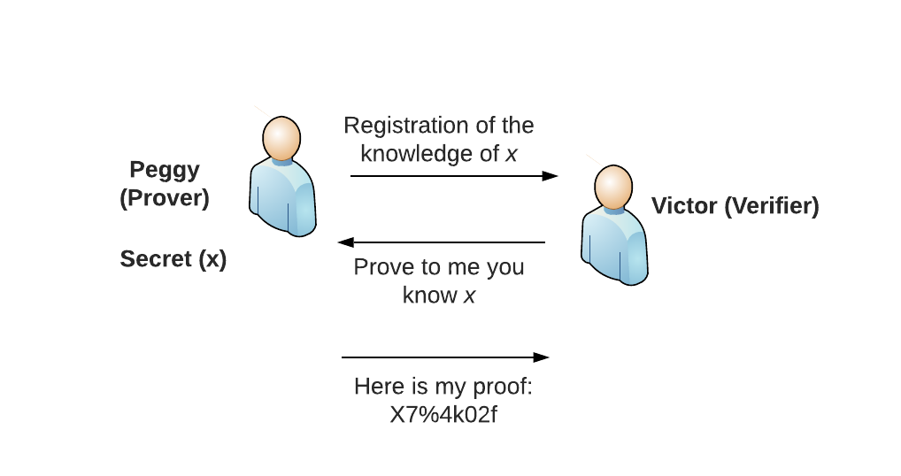
Interactive Zero-Knowledge Proof

Slide 15

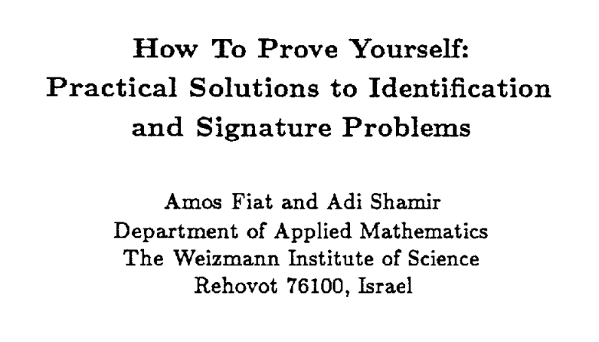

Zero Knowledge Proof

Slide 16
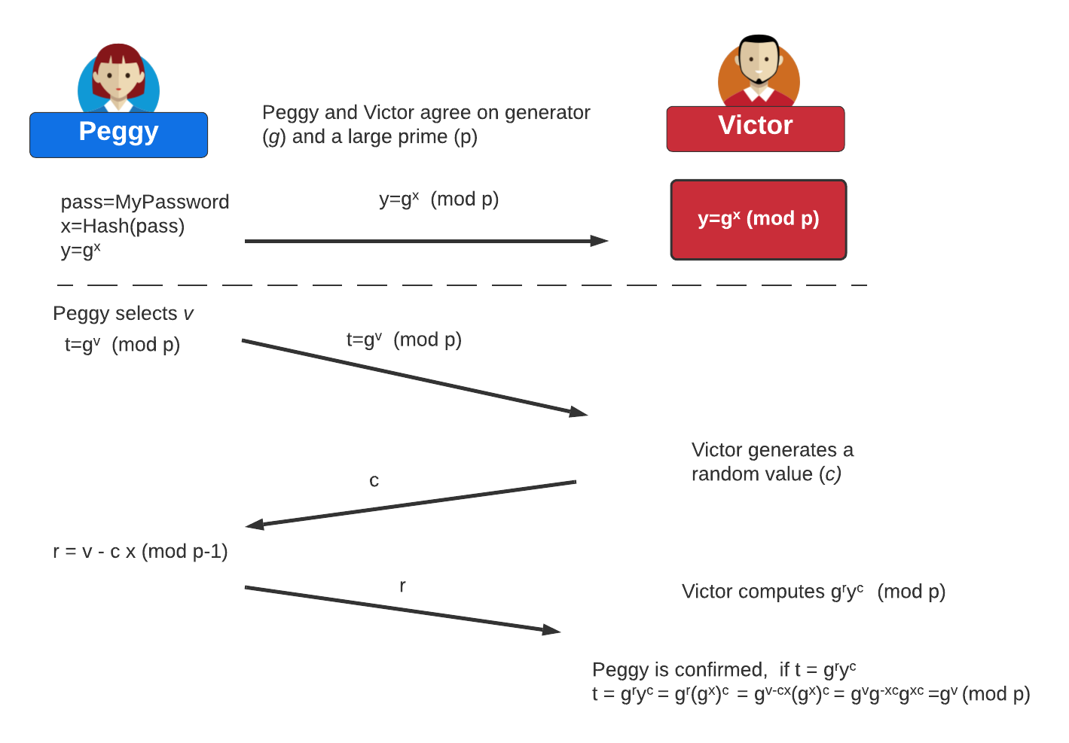
Interactive random oracle access
g^{r} y^{c} = g^{v- cx} (g^{x})^{c}
= g^{v- cx} g^{xc}
= g^{v- cx+ cx}
= g^{v}

Slide 17
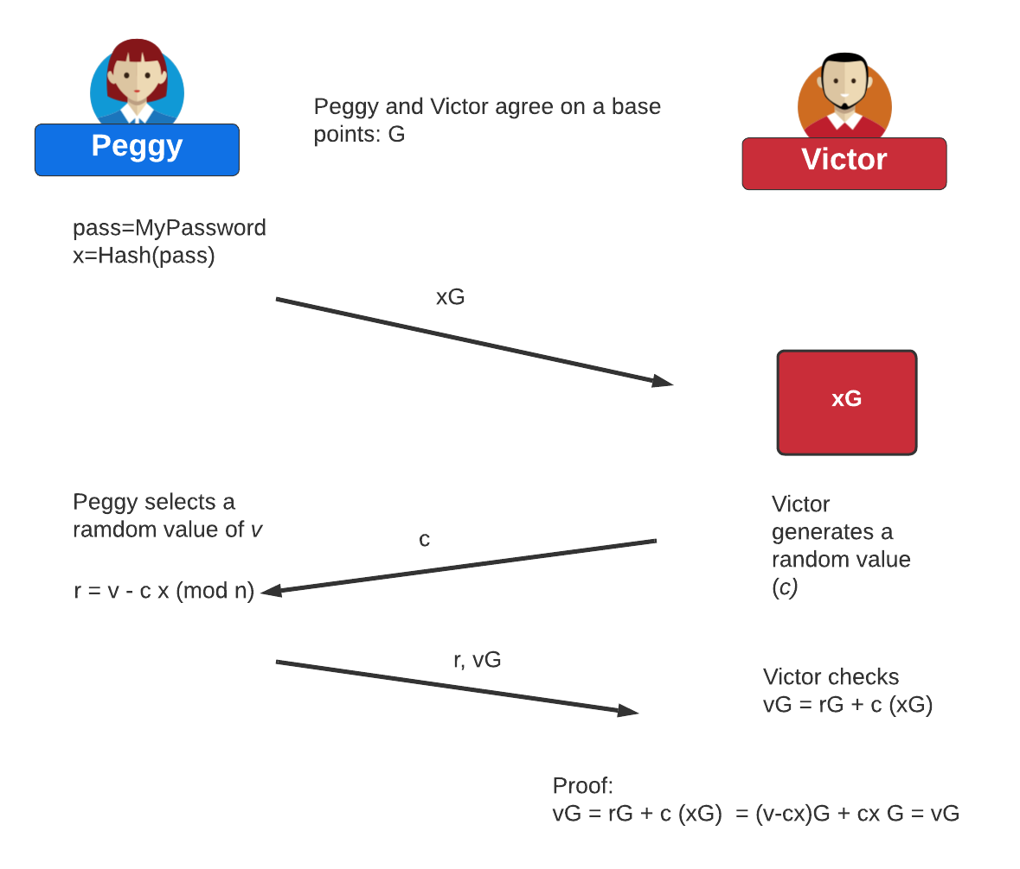
Zero-knowledge Proof (Interactive – Discrete Logs to ECC)

Slide 18
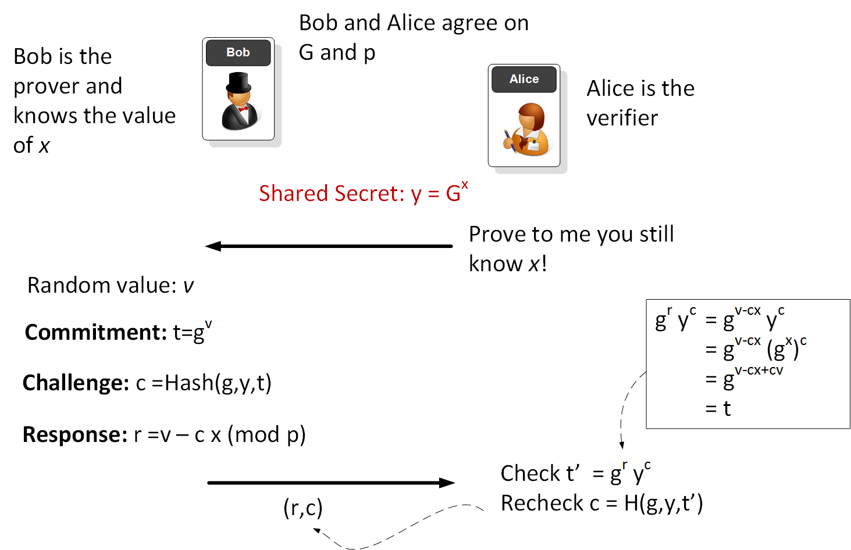
Non-interactive random oracle access Zero Knowledge Proof (Discrete Logs)

Slide 19
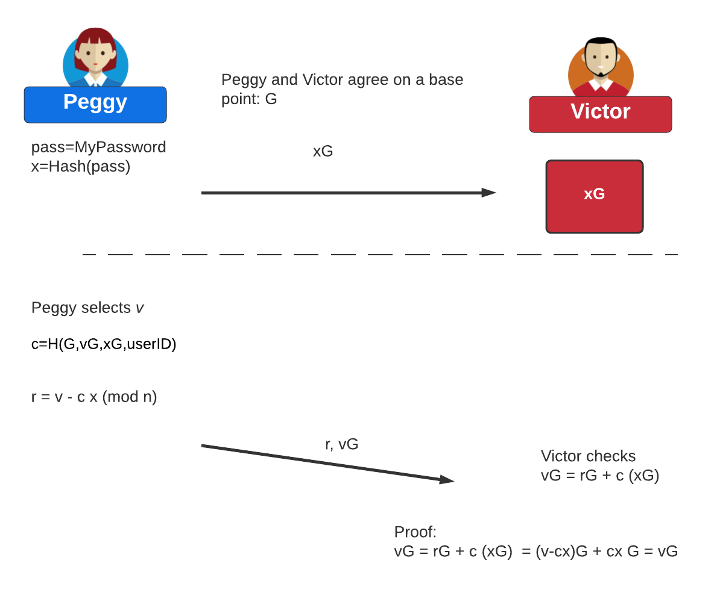
Non-interactive random oracle access Zero Knowledge Proof (ECC)

Slide 20
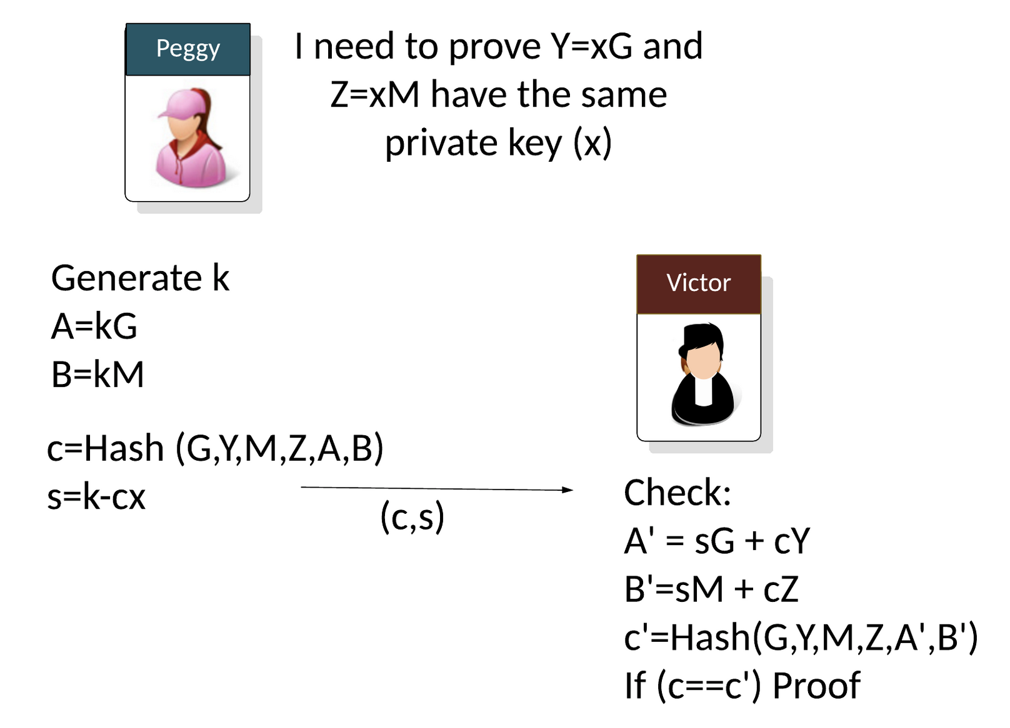
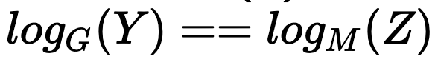
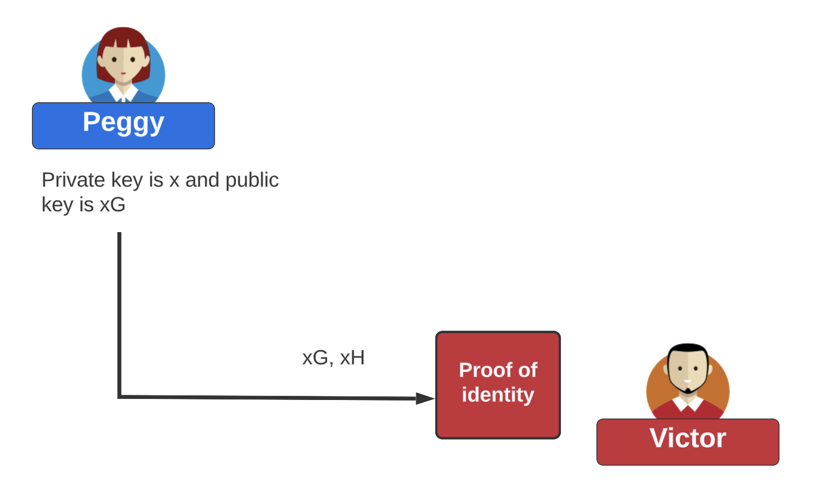
NIZK (Non-interactive Zero Knowledge) proofs of discrete - log equality

Slide 21
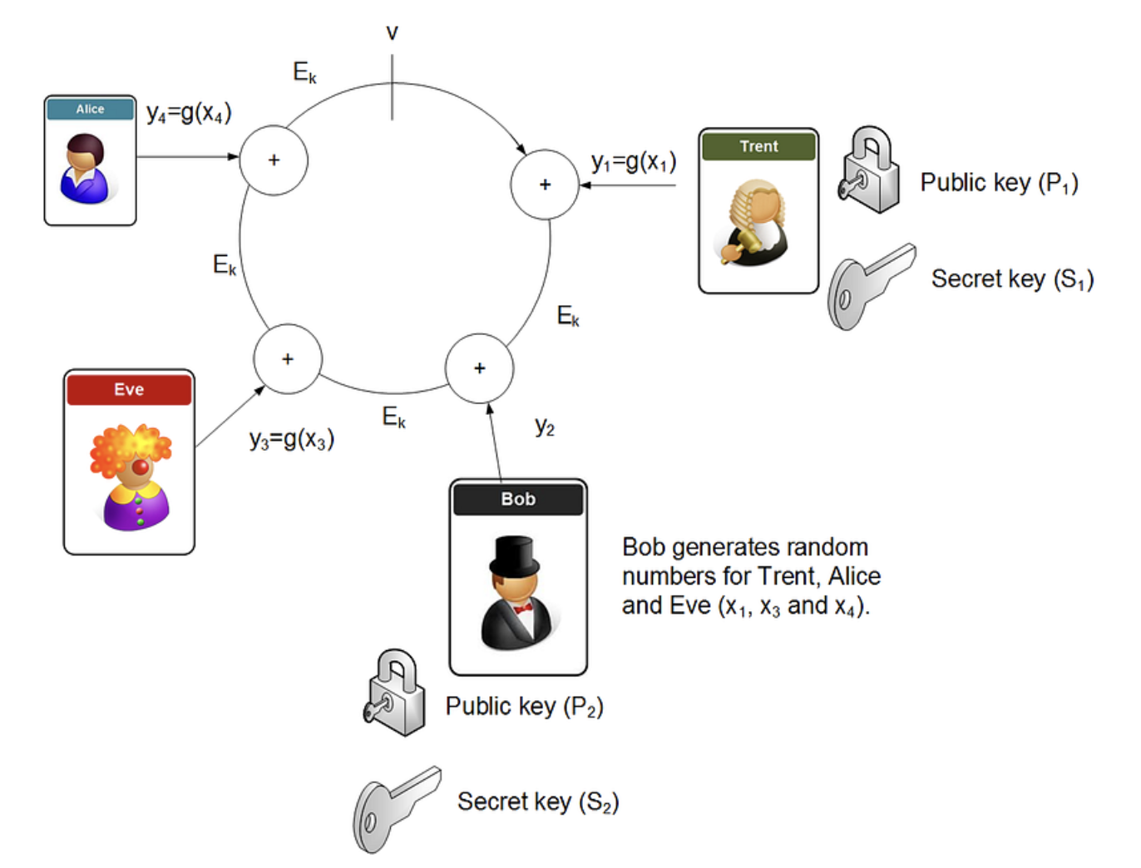
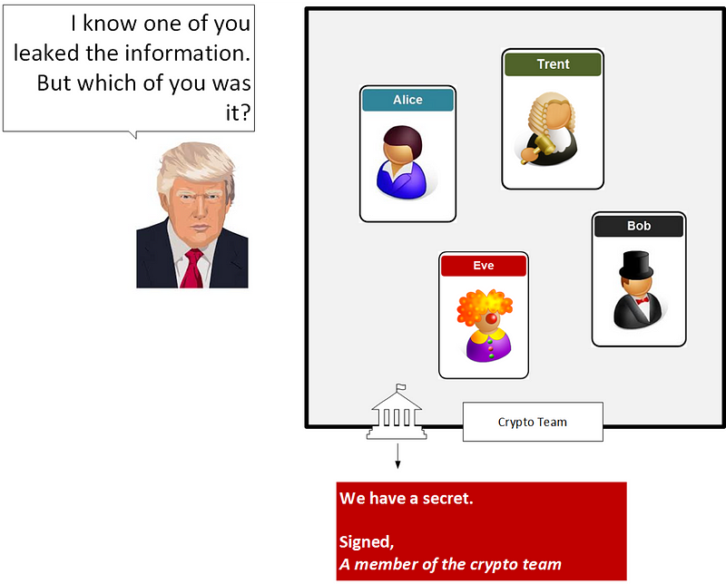
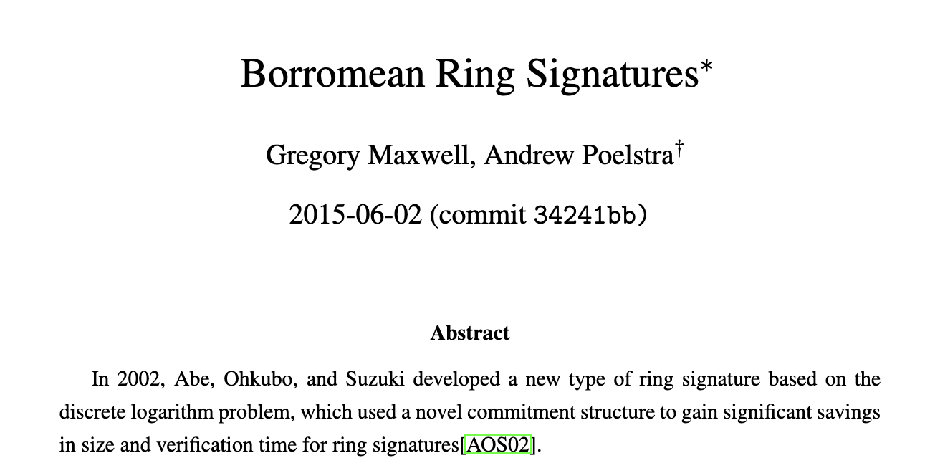
Ring Signatures
Ring signature, and which provides anonymity, unforgivably and collusion resistance.

Slide 22
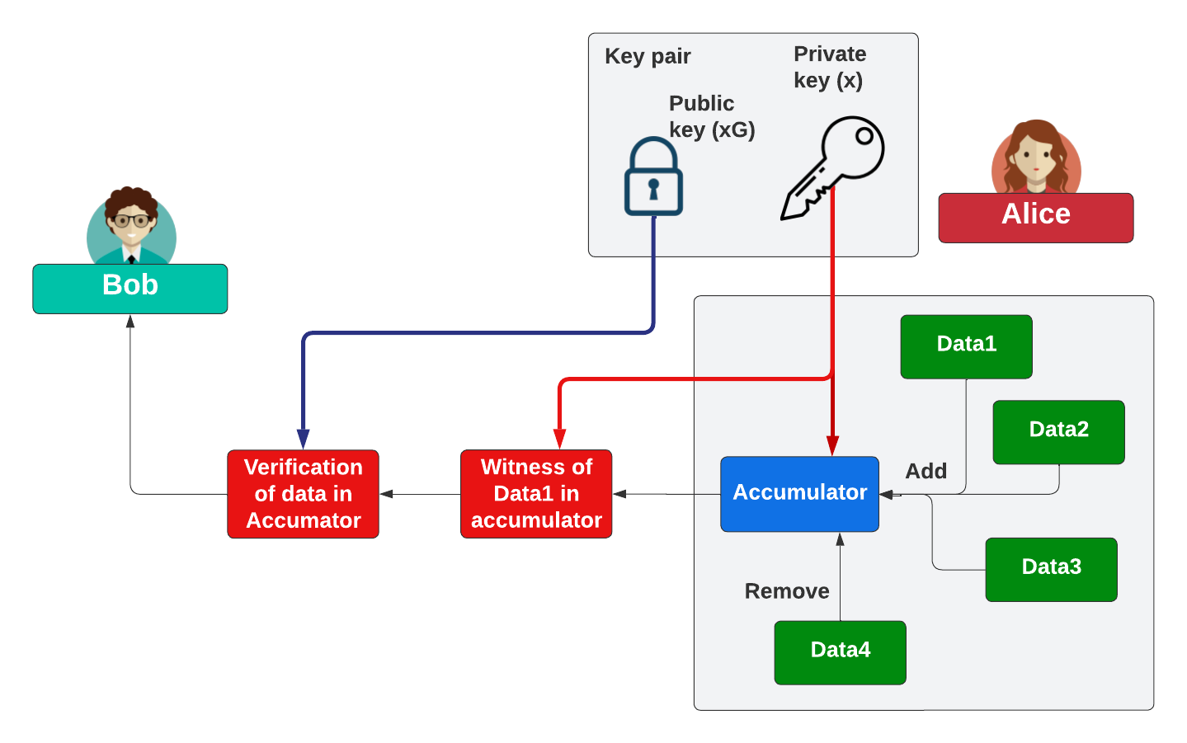
Accumulators

Slide 23
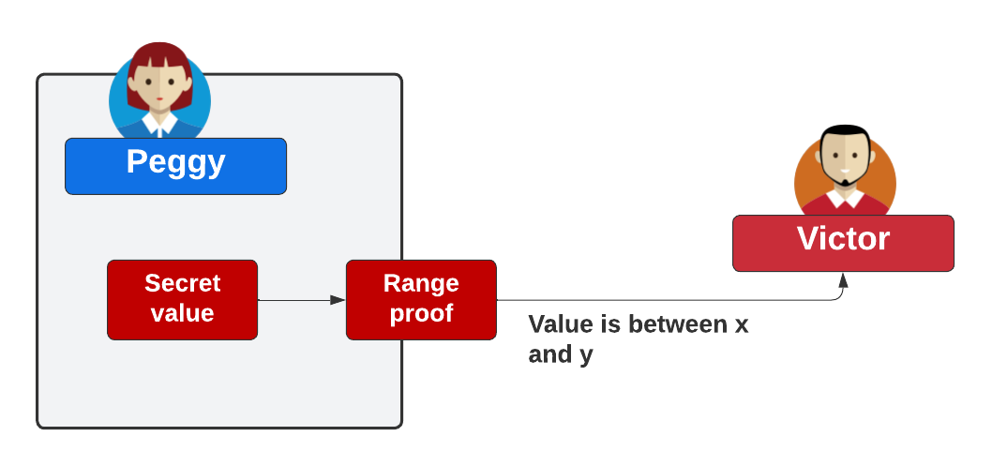
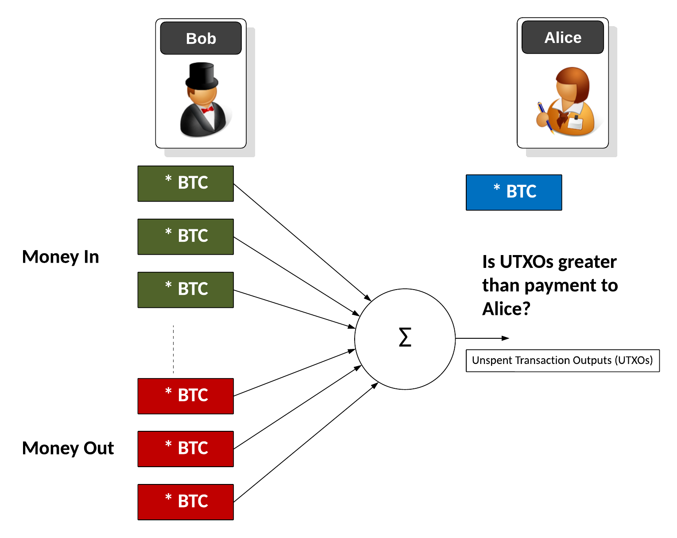
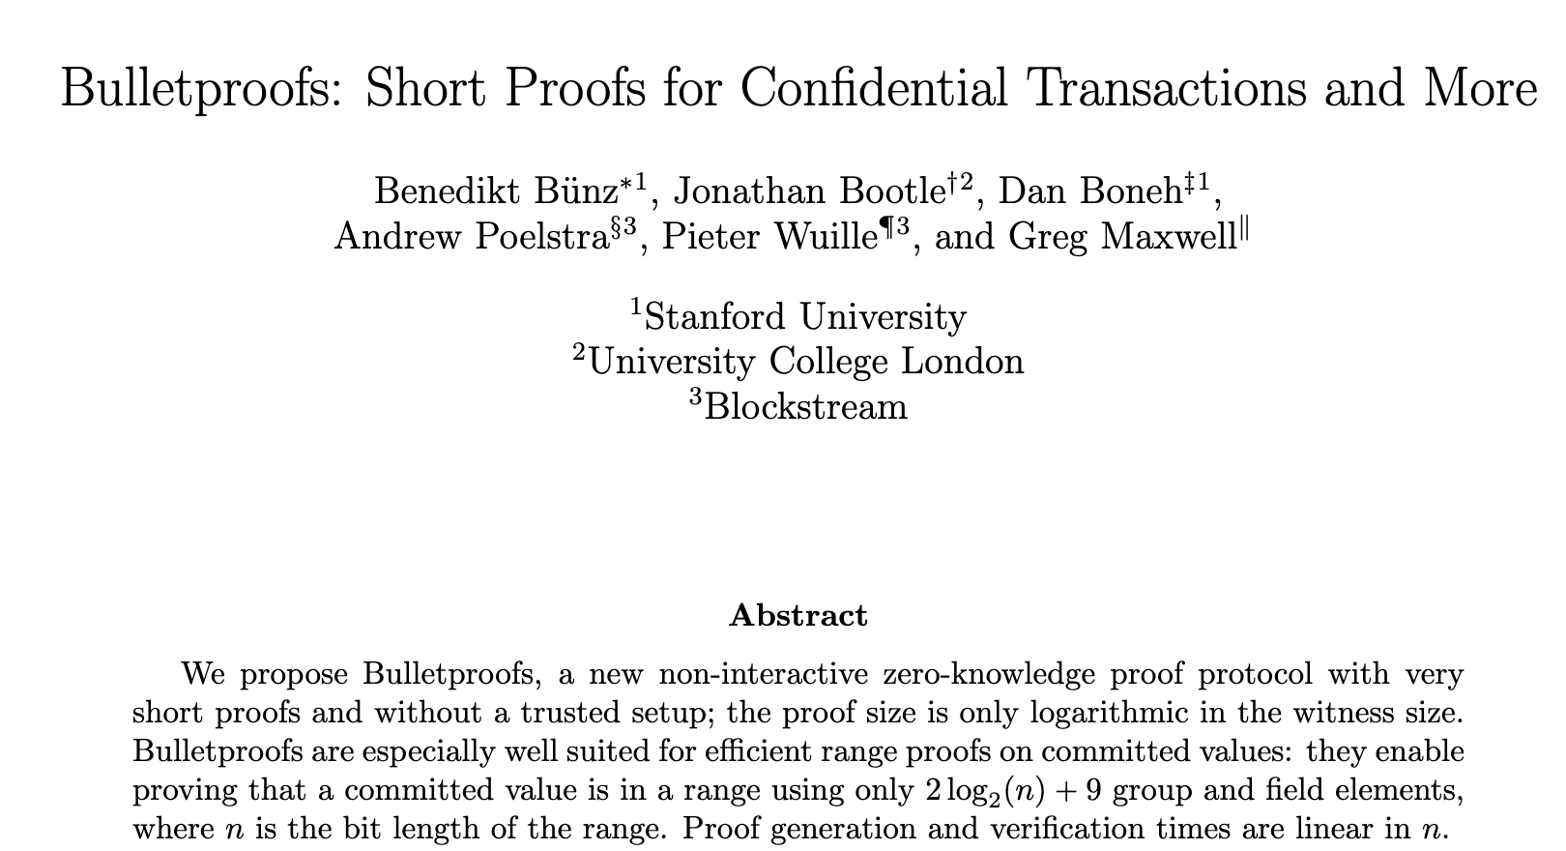
Range Proofs – such as Bulletproofs

Slide 24
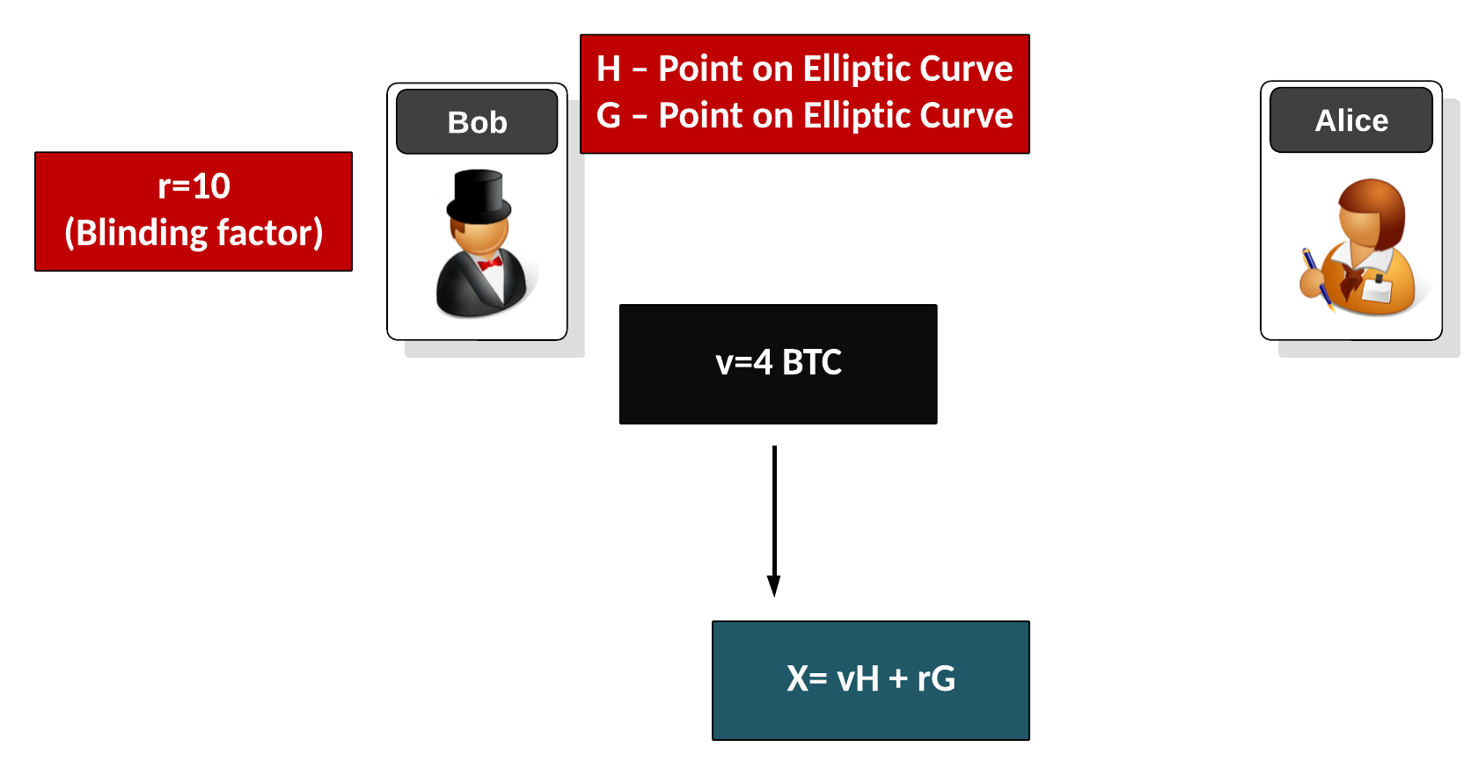
Pedersen Commitment

Slide 25
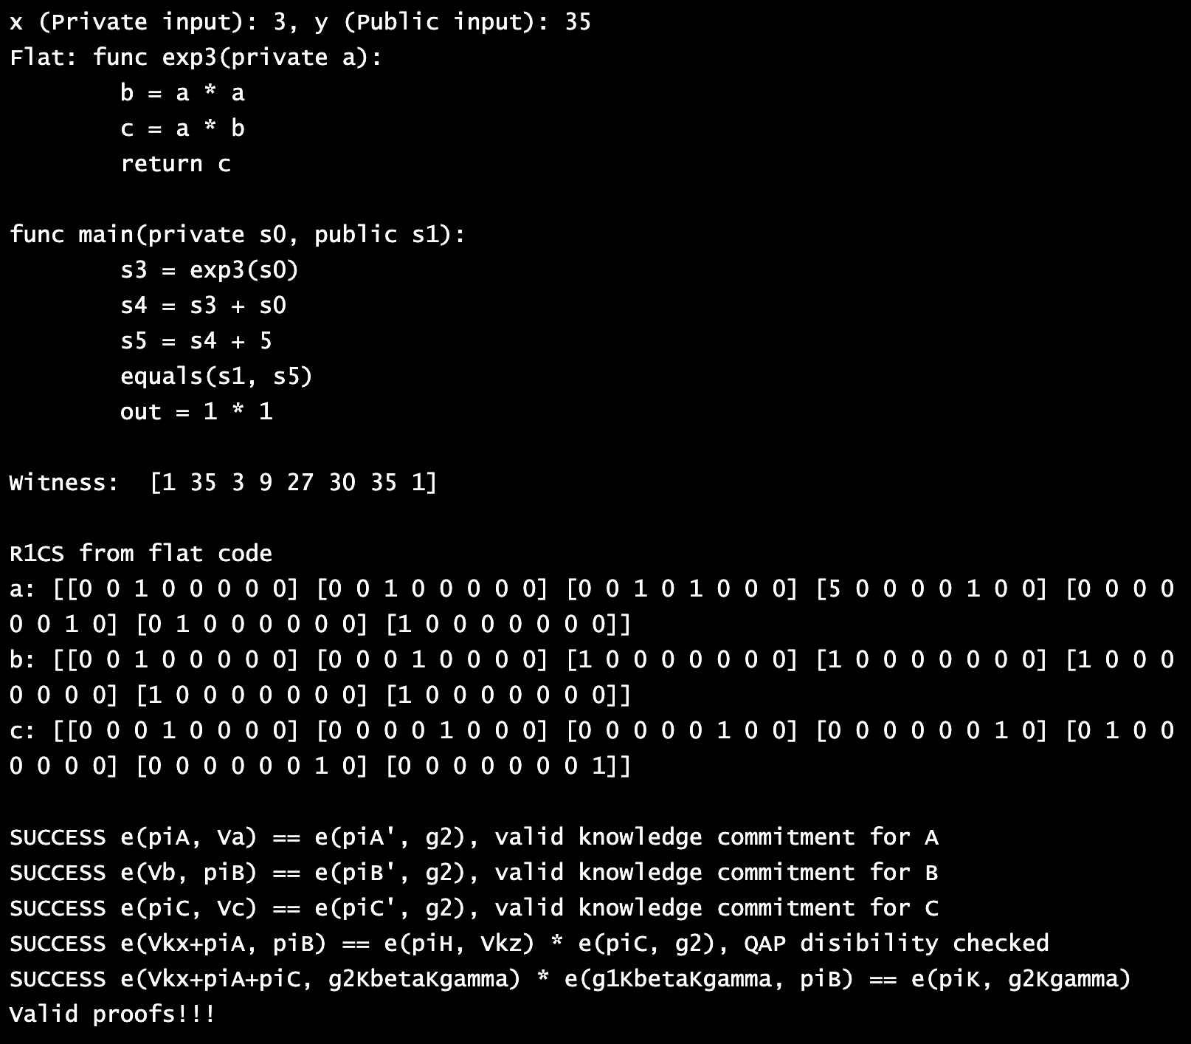
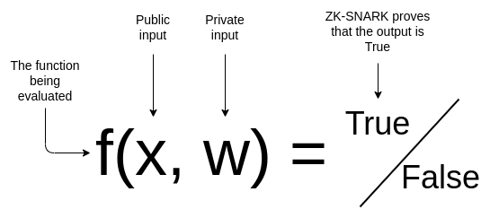
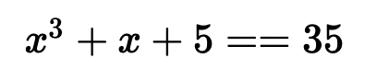
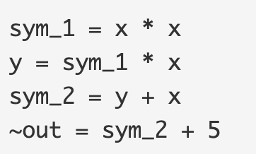
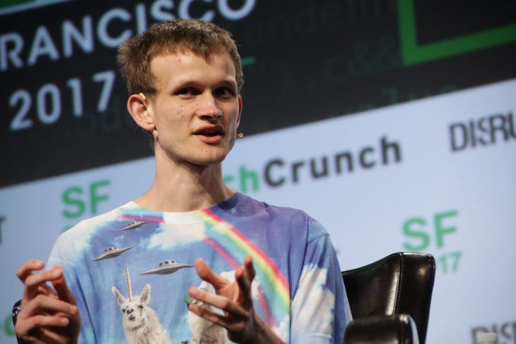
zkSnarks (Zero-Knowledge Succinct Non-Interactive Argument of Knowledge)– with R1CS (Rank 1 Constraint System)

Slide 26
Fully Homomorphic Encryption (FHE)
Prof Bill Buchanan OBE FRSE
https://asecuritysite.com/openfhe

Slide 27
FHE: Background
Prof Bill Buchanan OBE, Blockpass ID Lab
http://asecuritysite.com

Slide 28
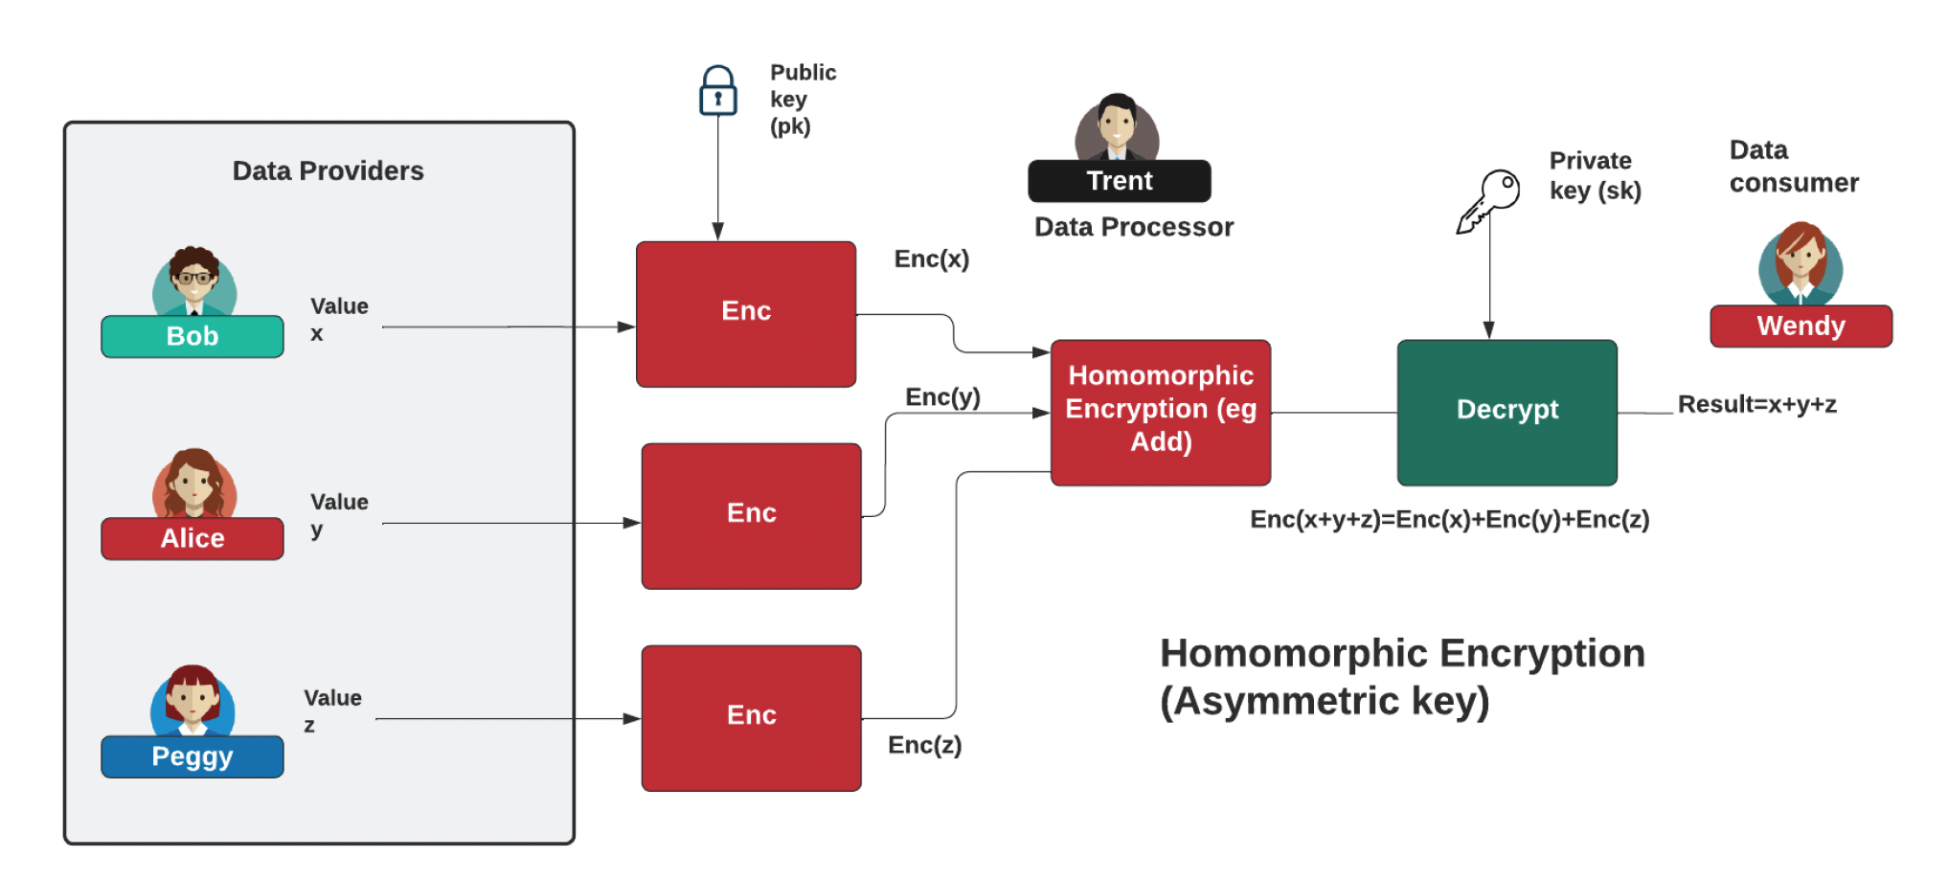
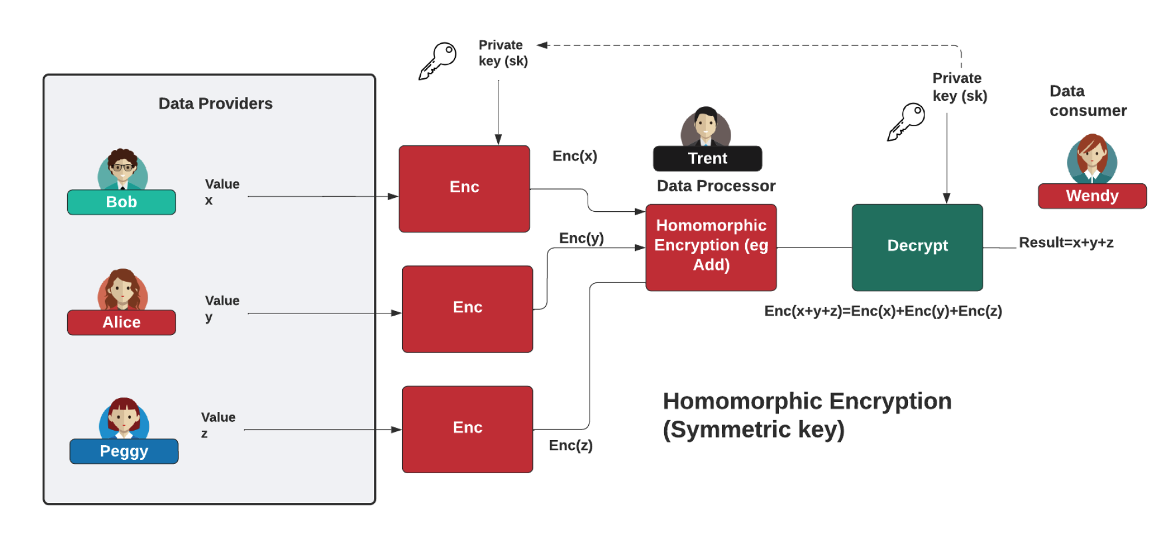
FHE

Slide 29
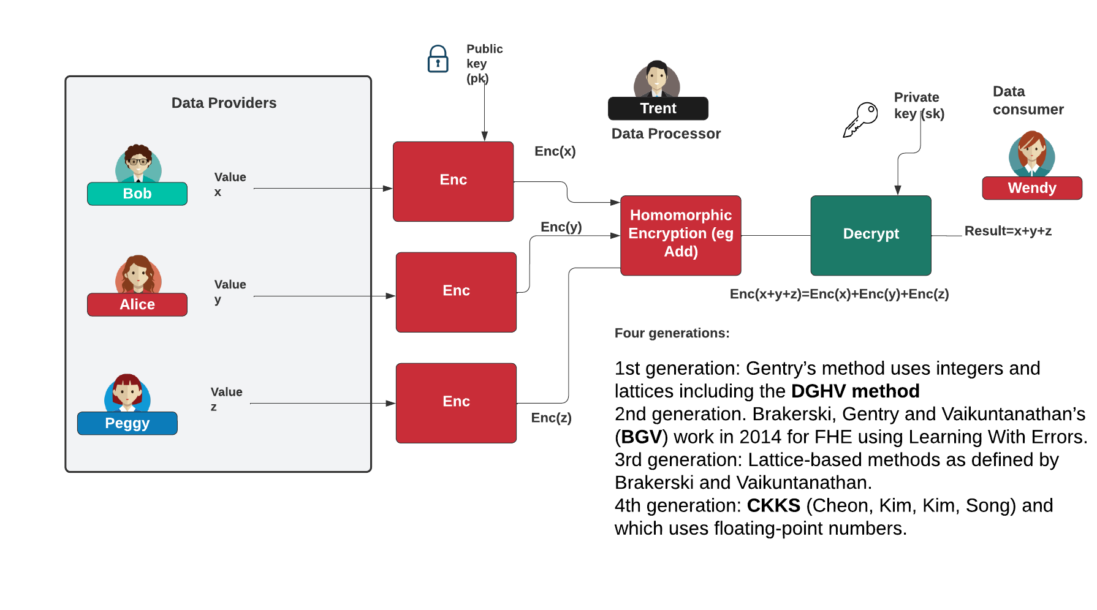

Homomorphic Encryption
https://asecuritysite.com/homomorphic/

Slide 30
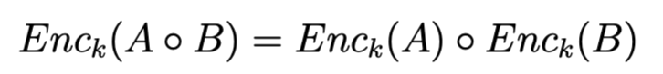
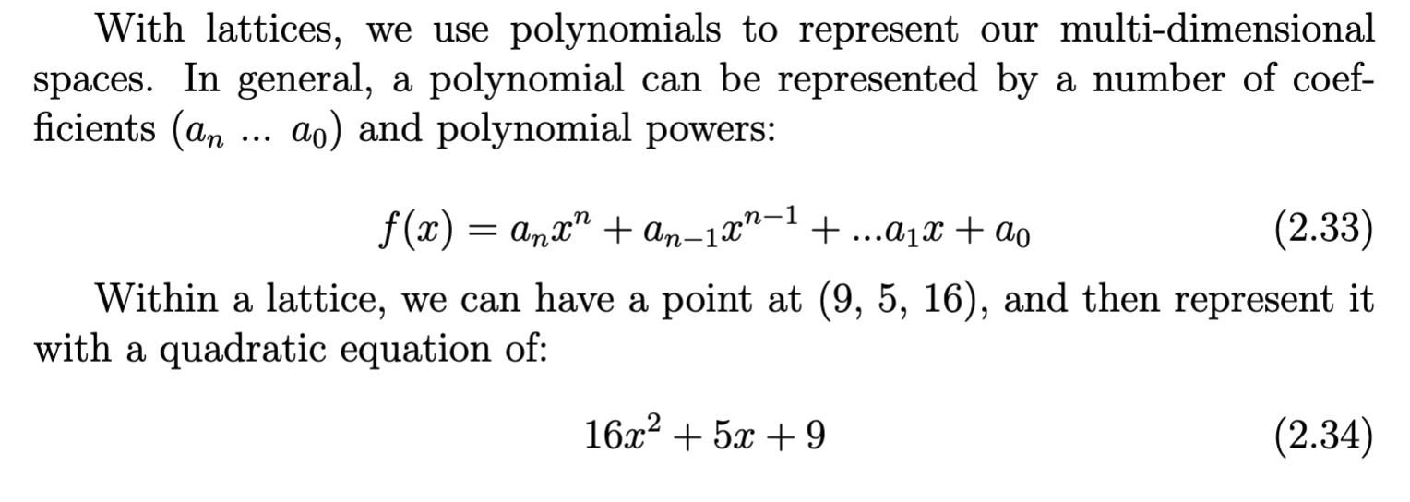
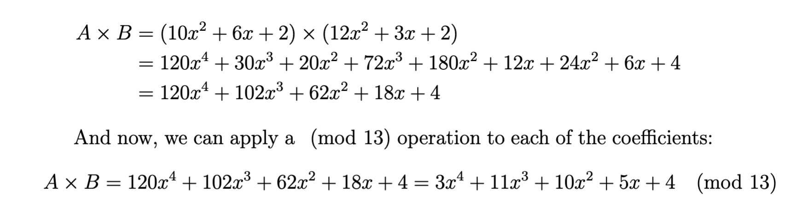
Polynomials

Slide 31
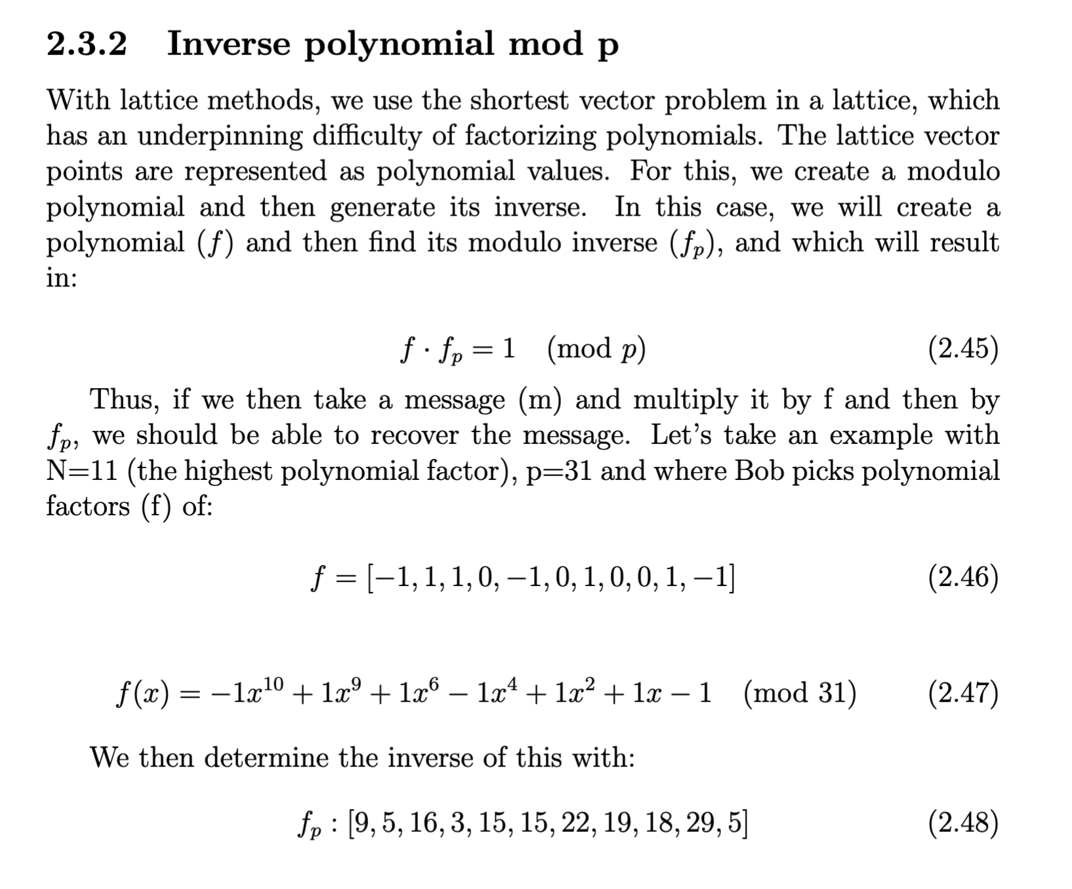
Inv Mod p

Slide 32
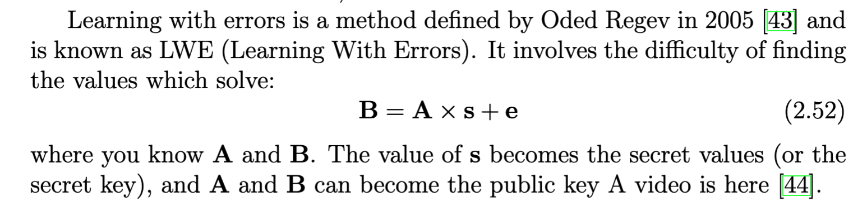
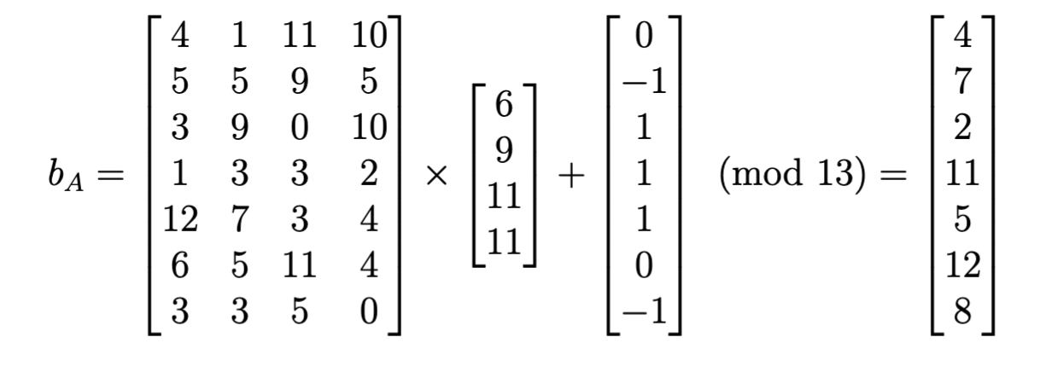
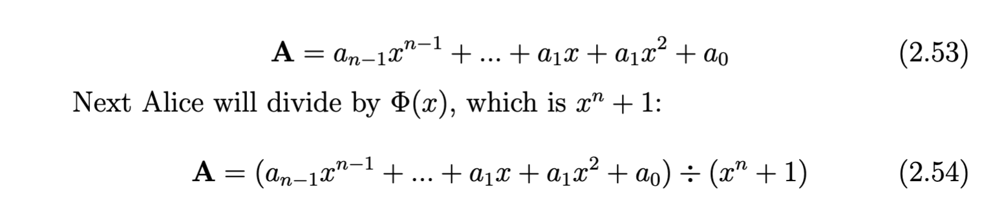
RLWE

Slide 33
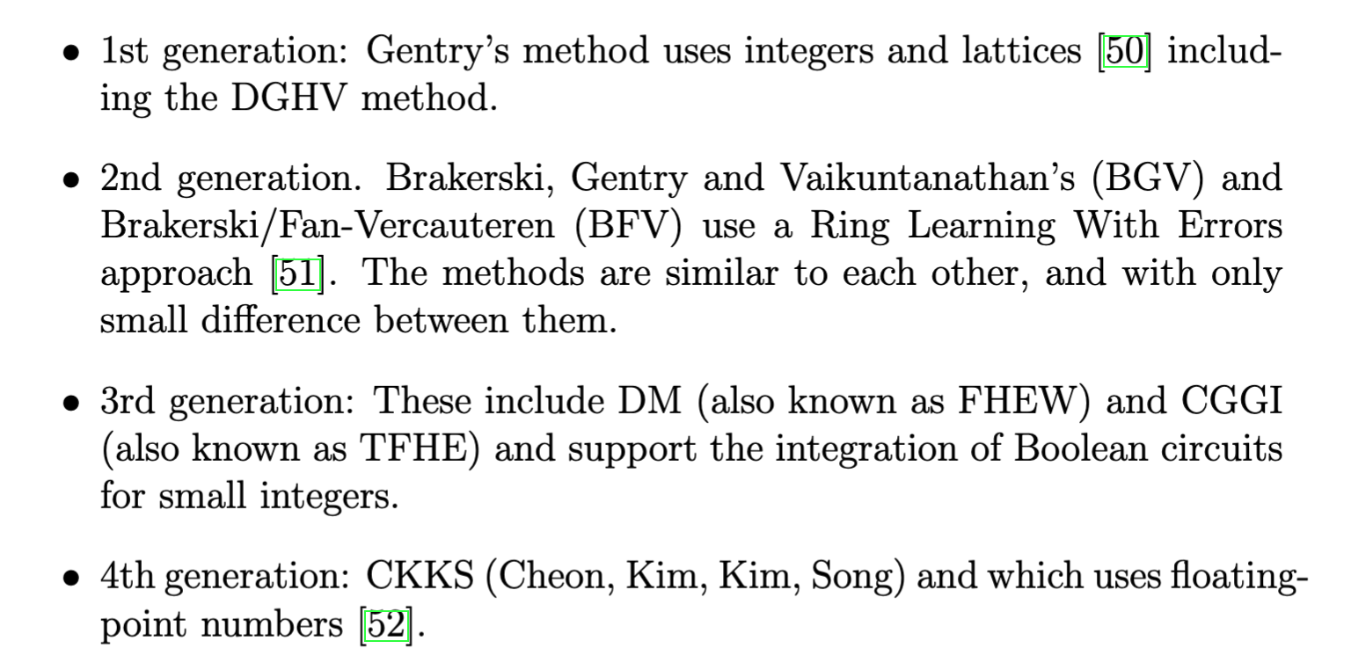
FHE

Slide 34
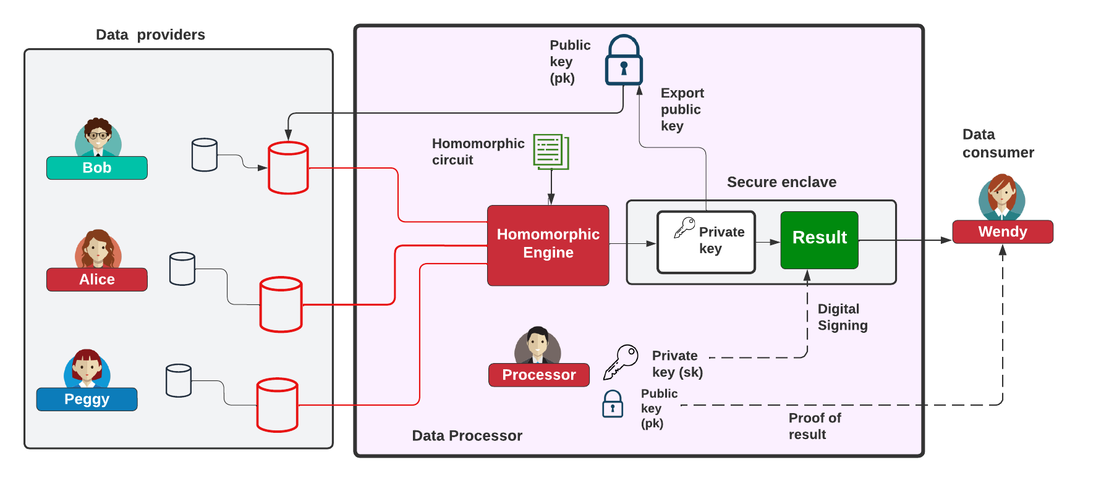
Homomorphic Processing

Slide 35
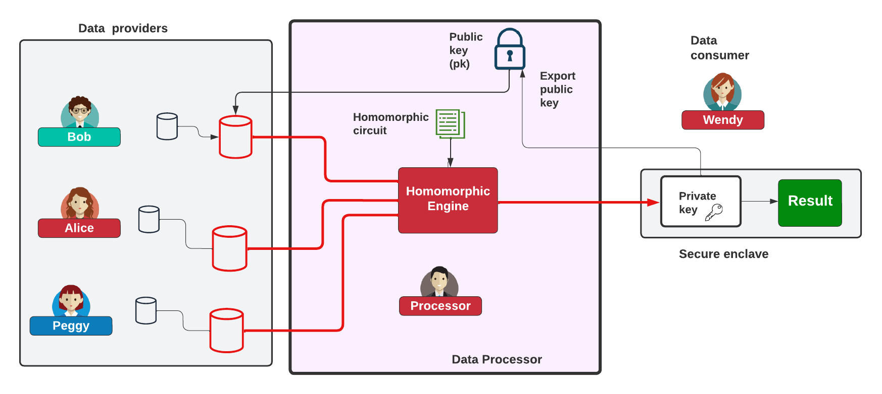
Homomorphic Processing

Slide 36
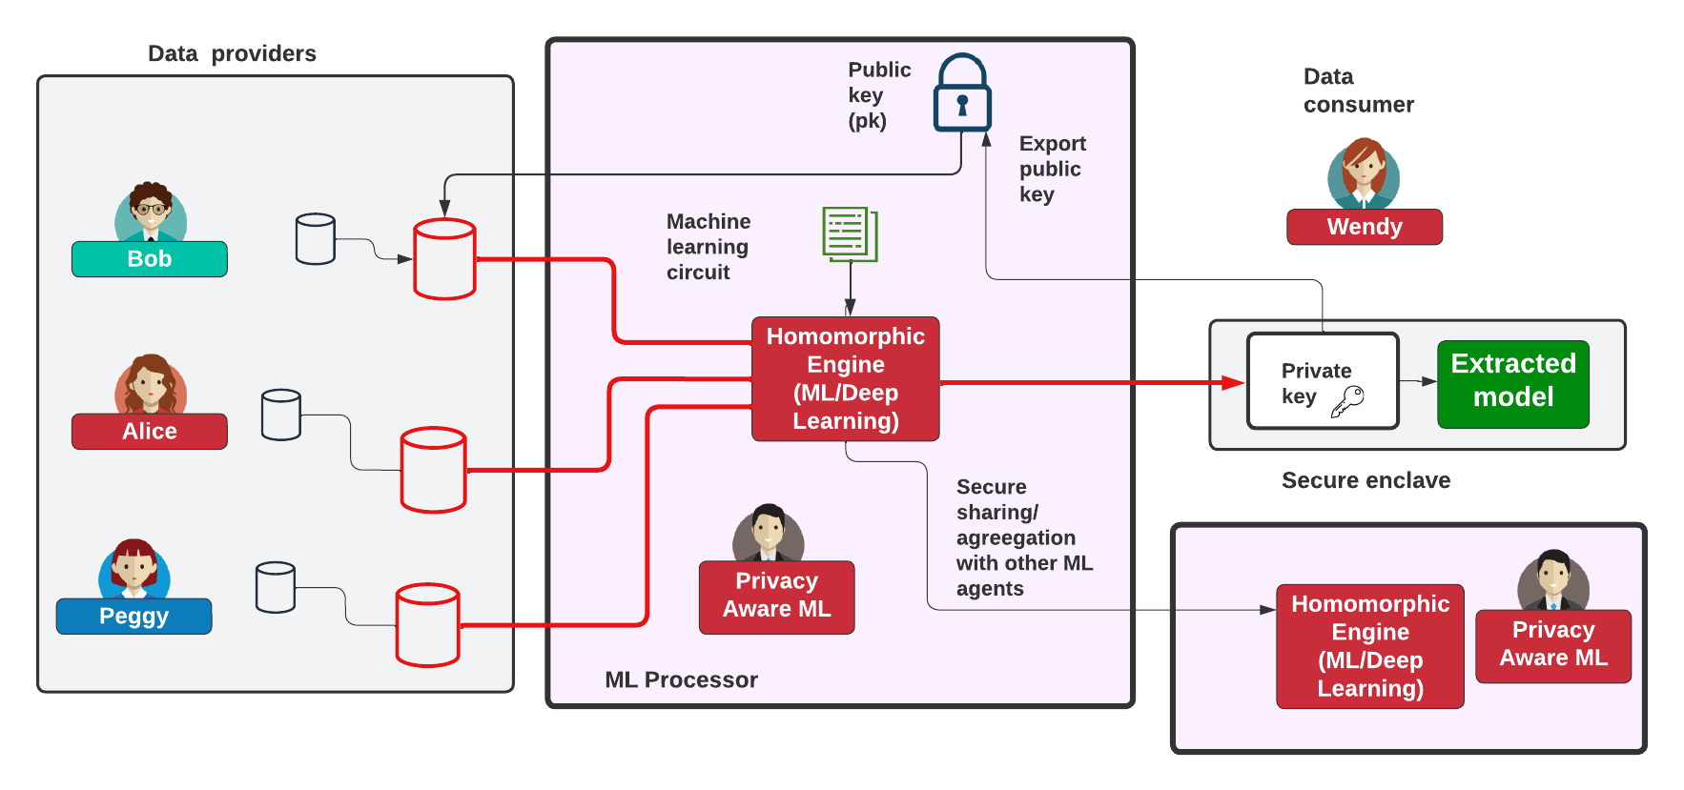
Homomorphic ML

Slide 37
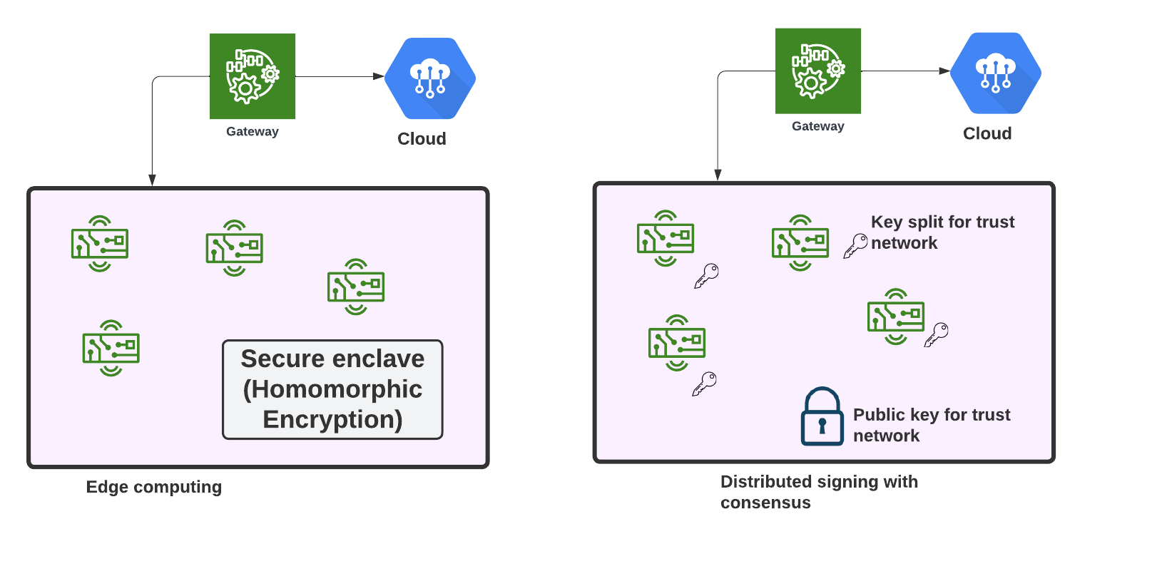
Edge Computing/Trusted Environment

Slide 38
FHE: Concepts and Code
Prof Bill Buchanan OBE, Blockpass ID Lab
http://asecuritysite.com

Slide 39
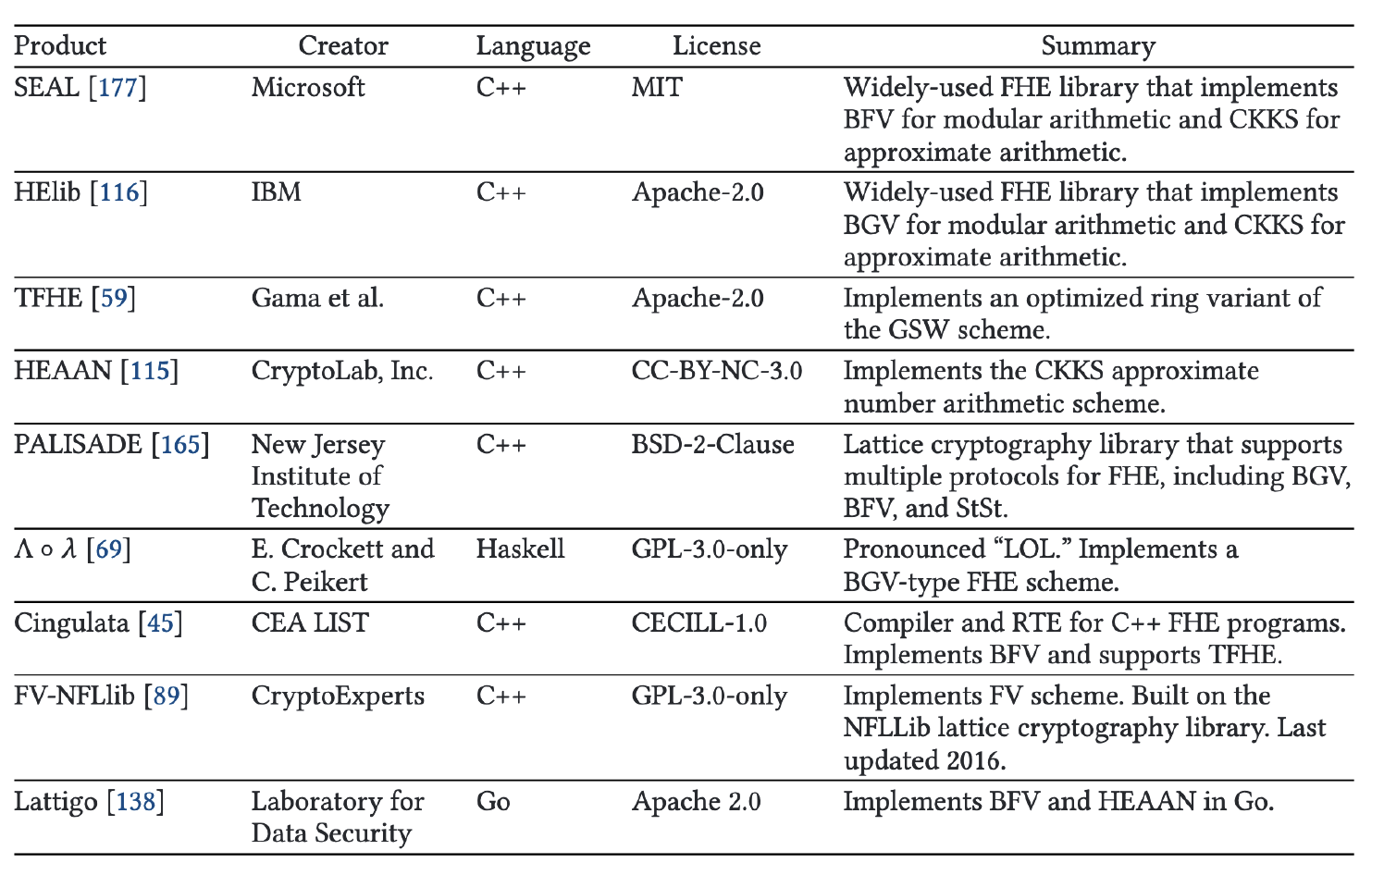
Libraries
OpenFHE

Slide 40
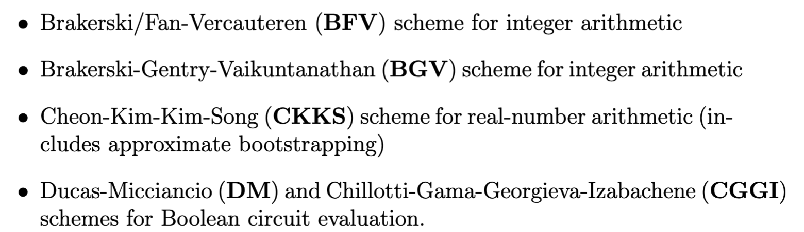
OpenFHE

Slide 41
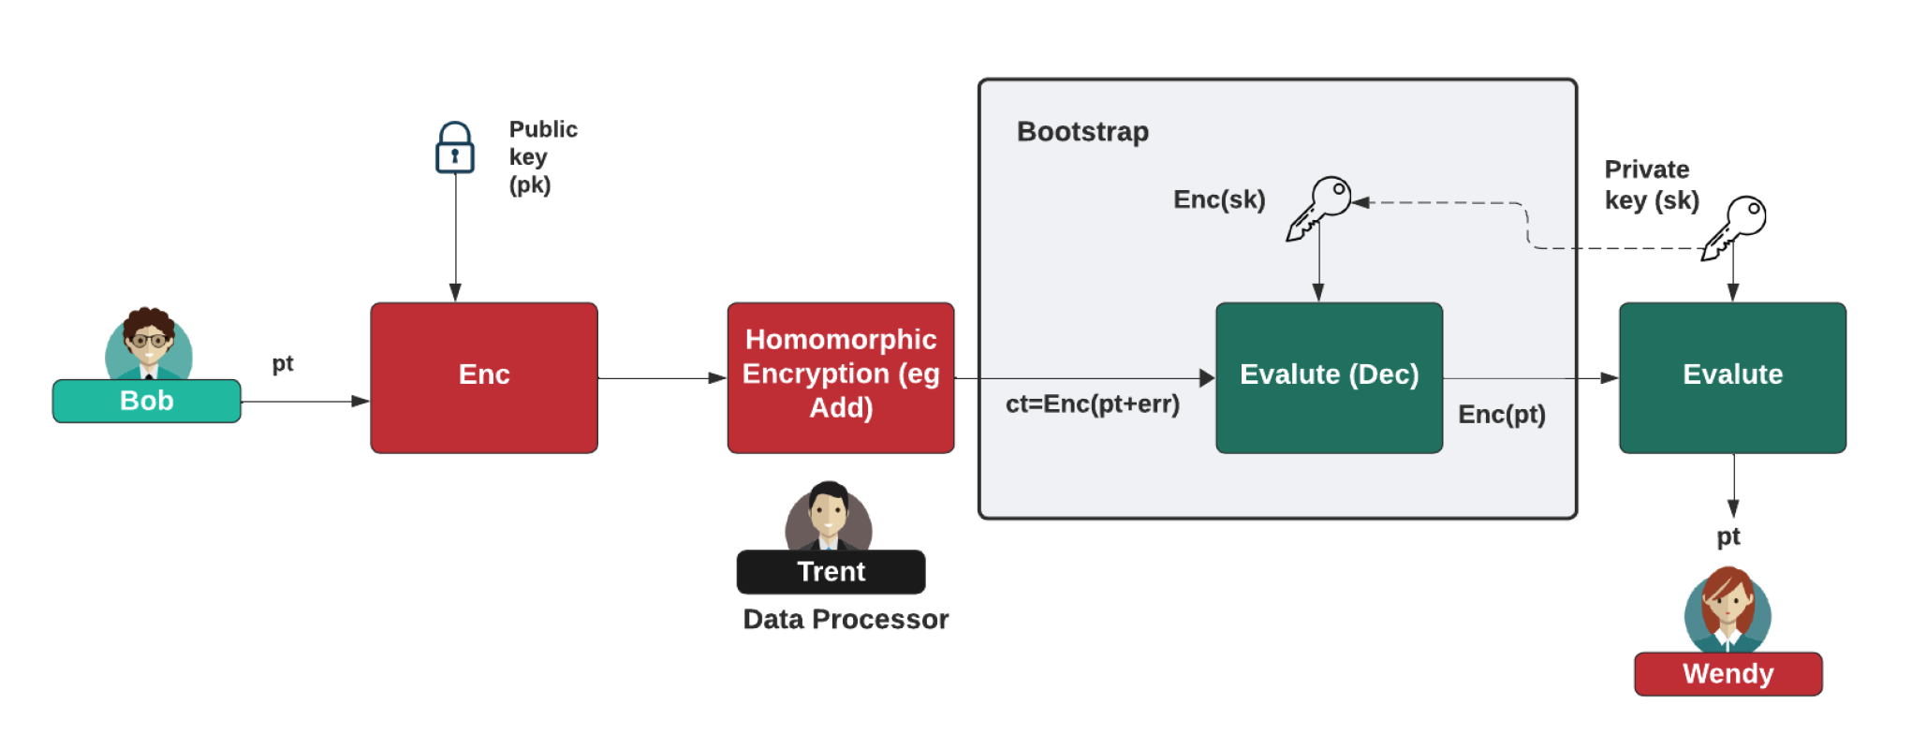

Bootstrapping

Slide 42


Bootstrapping and Slots
Each ciphertext can have an associated "level" and a value of "noise".
We have various levels. One multiplication consumes a level, and adds noise.
When we reach zero or the noise level is too high, we need to bootstrap - raises the level and reduce noise.

Slide 43


SEAL BFV/BGV
PolyModulusDegree: Defines number of coefficients in plaintext polynomials and the size of ciphertext elements. Must be a power of 2 (such as 1024, 2048, 4096, 8192, 16384, or 32768). Affects performance)
PlainModulus: Largest coefficient that plaintext polynomials can represent. Affects performance.
Add
Plaintext
Plaintext
Square
Encryptor
Evaluator
Decryptor
Ciphertext
Ciphertext

Slide 44

SEAL CKKS
PolyModulusDegree: Defines number of coefficients in plaintext polynomials and the size of ciphertext elements. Must be a power of 2 (such as 1024, 2048, 4096, 8192, 16384, or 32768). Affects performance)
Add
Plaintext
Plaintext
Square
Encryptor
Evaluator
Decryptor
Ciphertext
Ciphertext

Slide 45

CryptoContext and Parameters (BFV)
Plaintext Modulus
Multiplicative Depth
PKE Scheme Features
Generate key pair (sk, pk)
https://asecuritysite.com/openfhe/openfhe_00cpp

Slide 46


CryptoContext and Parameters (CKKS)
Multiplication depth
Scale Mod Size
https://asecuritysite.com/openfhe/openfhe_00cpp_ckks

Slide 47


BFV - Adding/Multiplying Two Numbers
https://asecuritysite.com/openfhe/openfhe_02cpp

Slide 48



CCKS - Adding/Multiplying Two Numbers
https://asecuritysite.com/openfhe/openfhe_05cpp

Slide 49


BFV - Batch Processing
https://asecuritysite.com/openfhe/openfhe_08cpp

Slide 50







MD/FHEW
https://asecuritysite.com/openfhe/openfhe_09cpp
https://asecuritysite.com/openfhe/openfhe_09cpp_pke

Slide 51





MD/FHEW
https://asecuritysite.com/openfhe/openfhe_11cpp
https://asecuritysite.com/openfhe/openfhe_11cpp_pke

Slide 52






MD/FHEW - MUX and Majority
https://asecuritysite.com/openfhe/openfhe_11cpp
https://asecuritysite.com/openfhe/openfhe_11cpp_pke

Slide 53



Chebyshev Functions
With approximation theory, it is possible to determine an approximate polynomial p(x)
that is approximate to a function f(x).
https://asecuritysite.com/openfhe/openfhe_18cpp

Slide 54



Polynomial Evaluation
https://asecuritysite.com/openfhe/openfhe_20cpp

Slide 55
FHE: Data Sharing
Prof Bill Buchanan OBE, Blockpass ID Lab
http://asecuritysite.com

Slide 56

Homomorphic Sharing

Slide 57

Multiparty Sharing

Slide 58

SmartCrypt

Slide 59

Using Symmetric Key for HE

Slide 60




Proxy Re-encryption (PRE)
https://asecuritysite.com/openfhe/openfhe_21cpp

Slide 61
FHE in the Cloud
Prof Bill Buchanan OBE, Blockpass ID Lab
http://asecuritysite.com

Slide 62


Symmetric/Asymmetric in Cloud

Slide 63


Searchable Encryption

Slide 64



Location Tracking

Slide 65

Privacy-aware biometrics/ID

Slide 66


Apple Privacy Aware

Slide 67
FHE: MPC
Prof Bill Buchanan OBE, Blockpass ID Lab
http://asecuritysite.com

Slide 68




Threshold Encryption
https://asecuritysite.com/openfhe/openfhe_16cpp
https://asecuritysite.com/openfhe/openfhe_17cpp

Slide 69
FHE: ML
Prof Bill Buchanan OBE, Blockpass ID Lab
http://asecuritysite.com

Slide 70



Matrix Operations

Slide 71

Private Prediction as a Service
[87] M. Iezzi, “Practical privacy-preserving data science with homomorphic encryption: an overview,” in 2020 IEEE International Conference on Big Data (Big Data). IEEE, 2020, pp. 3979–3988.

Slide 72





Logistic Function
https://asecuritysite.com/openfhe/openfhe_19cpp

Slide 73



Matrix Operations
https://asecuritysite.com/openfhe/openfhe_13cpp
https://asecuritysite.com/openfhe/openfhe_14cpp

Slide 74



Matrix Operations
https://asecuritysite.com/openfhe/openfhe_27cpp

Slide 75




Matrix Operations
https://asecuritysite.com/openfhe/openfhe_27cpp
https://asecuritysite.com/openfhe/openfhe_26cpp

Slide 76


Matrix Operations
https://asecuritysite.com/openfhe/openfhe_27cpp
https://asecuritysite.com/openfhe/openfhe_26cpp

Slide 77



Matrix Operations
https://asecuritysite.com/openfhe/openfhe_28cpp
https://asecuritysite.com/openfhe/openfhe_29cpp

Slide 78


GWAS (Gnome-wide Association Studies)

Slide 79

SVM

Slide 80


Concrete-ML

Slide 81
Future of Digital Trust
Prof Bill Buchanan OBE FRSE
https://asecuritysite.com
Zero Knowledge Proofs Fiat Shamir, DLEQ, zkSnarks,
Ring Signatures, Range Proofs, Accumulators, Pedersen Commitments
Homomorphic Encryption:
Basics
Concepts and Code Data Sharing Cloud Processing MPC Machine Learning

